Slide 1
TEAM - E
Alex Swati
Rucha

Slide 2
Project – State of Oklahoma (funding decisions)
We are independent analysts, studying the correlation between median household income, education(school ratings and high school dropouts) and crime in the state of Oklahoma( by each county)
Based on our findings the state officials will take a call on diverting funds to and away from the issues mentioned above.

Slide 3
Hypothesis-
Ho 1: Crime and Income are inversely related (as one goes up, the other decreases).
Ha 1: Crime and Income show no inverse relations and correlations.
Ho2 : Income & Education (school ratings) are directly related.
Ha2 : Median household income and Education (school ratings) are not related.

Slide 4
Data Collection
API’s
Census API to get all counties for the state.
Google Map API to get latitude and longitude for counties.
SchoolDigger API to get the school ratings.
Websites
FBI USR reports (CSV files)
Data.gov for median income per county and school dropouts.

Slide 5
Data munging
Data collected is a combination of APIs and CSV files based on availability.
Collected from mostly gov agencies.
Needed reformatting and cleaning of NaN values.
Merged on common key County Name.
Schools by county
Crime rate by county
Gmap to locate lat and lon of counties

Slide 6
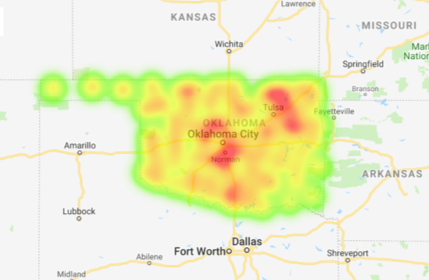
Findings A. Median Household Income
National Average Median Income is $60,309 (for year 2016)
Average Median Income for Oklahoma is $49,839 (as per our data)

Slide 7
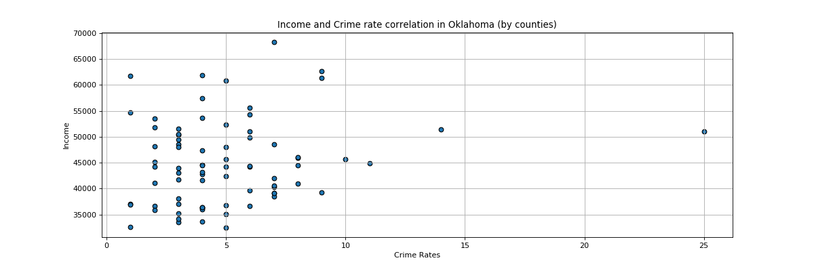
B. Income & Crime

Slide 8
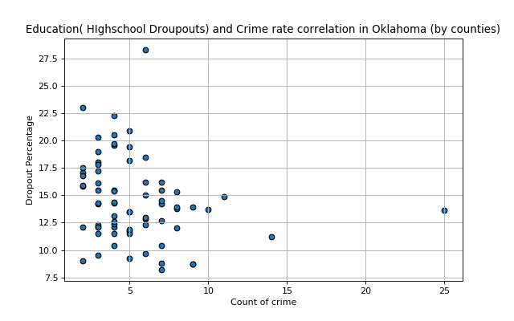
C. High school dropouts & Crime

Slide 9
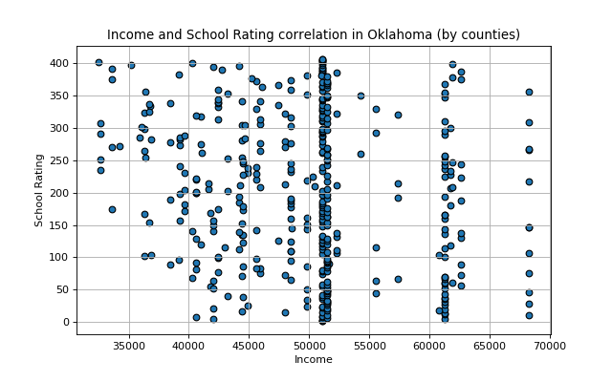
D. Income & School Ratings

Slide 10
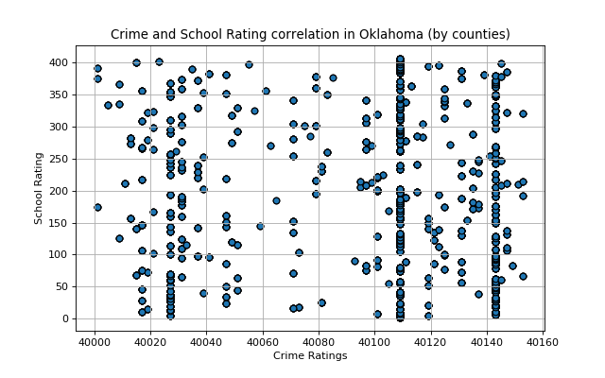
E. Crime & School Ratings

Slide 11
Testing Hypothesis using t-tests
The data collected was average median income per household.
Decided to use t-test by generating random samples and dividing in 2 sets.
The testing was done for both the hypotheses.

Slide 12
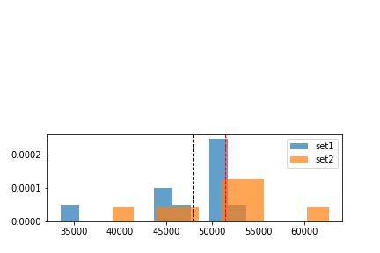
Hypothesis 1 - Crime Vs. Income
Ttest_indResult(statistic=-1.2696903390980516, pvalue=0.22048853296066728)

Slide 13
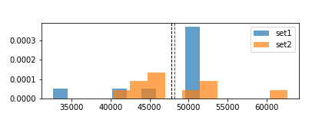
Hypothesis - 2 (Income Vs. Education)
Ttest_indResult(statistic=-0.12665403368003017, pvalue=0.9006183025299941)

